Slide 1

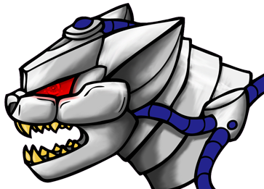





Team 3181: Pittsford Panthers The Pittsford Panthers FIRST Robotics team is comprised of approximately 30 students from Pittsford Mendon and Pittsford Sutherland High Schools. Our variety of students and their variety of talents help us work together to build a working robot. ~~~~~~~~~~ Our Sponsors | Pittsford High Schools Visit our team website at: www.pittsfordrobotics.org | FIRST Robotics Team 3181 Pittsford Panthers - Pittsford, N.Y.-
Look inside for info on our robot!

Slide 2
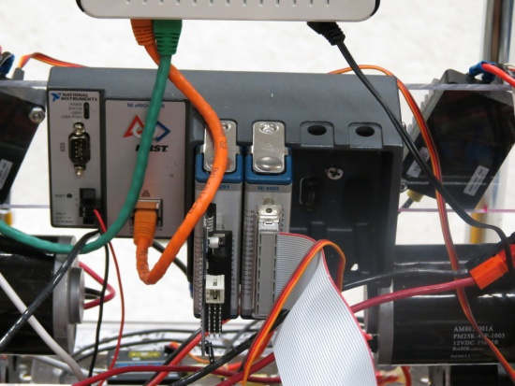
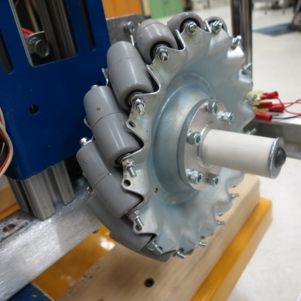
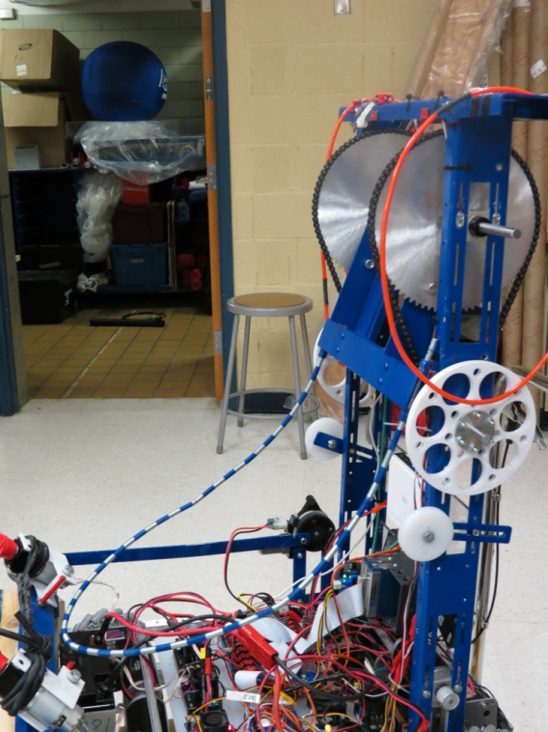
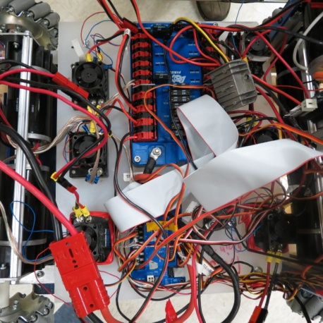
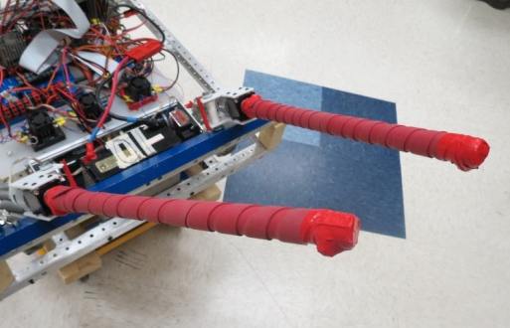
Programming:
The robot uses and ultrasonic range finder that controls autonomous mode.
This calculates the angle for the shooter.
Electrical/Wiring:
Uses 6 CIM Motors and 3 Andy Mark motors.
Driven by 3 Talon motor controllers and 3 Victor controllers.
Mobility:
The robot uses 4 Mecanum wheels powered by CIM motors for maximum maneuverability.
Attached to a Toughbox mini gearbox for a low center of gravity.
Ball Retrieval/Passing:
“El Torro” Mechanism- 2 PVC tubes coated in rubber are connected to 2 Andy Mark motors. They spin inwards to load the ball into the shooter.
Can be raised and lowered by a single Window motor.
Shooting Mechanism:
A long, catapult arm is driven by 2 80-tooth sprockets.
The sprockets are attached to 2 CIM motors by a pulley system.
The catapult is built from a long wire formed into a U-shape.

